Slide 1
Supporting Senior Center Professionals

Slide 2
Who We Are
The Center for Aging and Disability Education and Research (CADER) is located at Boston University School of Social Work and is dedicated to strengthening the workforce that provides health and long-term supports and services to older adults and people with disabilities.
CADER offers a wide range of online training courses and certificate programs for learners at all levels of experience.
CADER programs and courses apply a competency-focused approach to comprehensive training, committed to enhancing the skills of practitioners in the field.
Notes:
Mention LC

Slide 3
CADER Program Benefits
Accessible - Our courses are online and self-paced, allowing you to complete them anywhere and at any time
Quality Content - Content developed by subject matter experts and reviewed by practitioners
Skill-based - Tied to specific competencies needed for effective practice in the field
Professional Development - Receive credentials from a nationally respected university that enhances your skill set and improves your qualifications
Make a Difference - Training is designed so that you can put it into practice immediately, helping to improve the lives of older adults and people with disabilities
Learner Support - Our staff will provide training support to help learners complete our programs

Slide 4
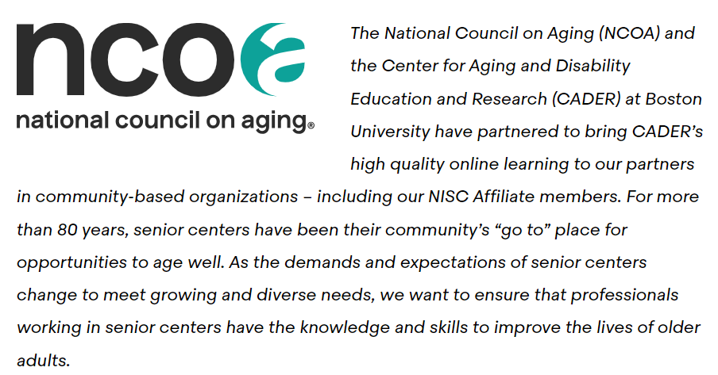
NCOA & BU CADER Training Partnership
https://thenetwork.bu.edu/ncoa-training-portal/
Notes:
Portal for NCOA – BHA and Volunteer

Slide 5
Enhancing Behavioral Health Competencies for Senior Center Staff:
Lessons Learned from Workforce Training Efforts

Slide 6
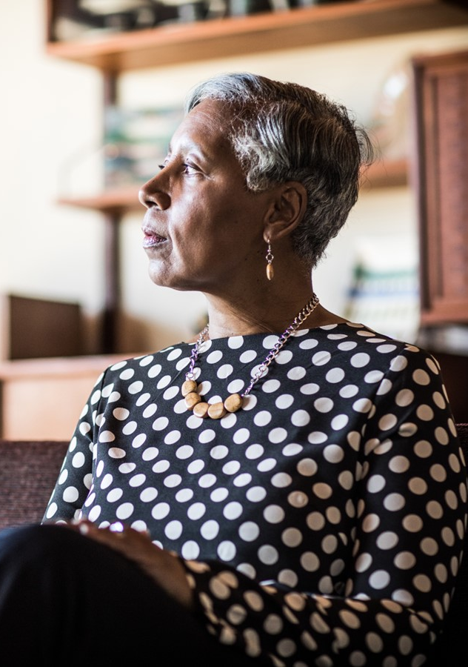
Background
In 2019, the U.S. population aged 65 and older numbered 54.1 million, or 16% of the total population
As the population of older adults grows, so does the prevalence of mental health and substance use concerns among this population
Expansion of interventions to support older adults’ mental health and wellness is an important preventative measure
Senior Centers are an ideal location for behavioral health education programs as they are the go-to place for many older adults
Competency-based trainings are a pragmatic and effective way to enhance the skillsets of staff at community-based agencies to identify, support, and refer older adults to necessary care

Slide 7
Behavioral Health in Aging Certificate
Five Courses:
Mental Health and Aging Issues
Suicide Prevention among Older Adults
Mental Wellness and Resilience among Older Immigrants and Refugees
Substance Use among Older Adults
Alzheimer’s Disease and Other Dementias
The Behavioral Health and Aging (BHA) Certificate was created by the Center for Aging & Disability Education & Research (CADER) at Boston University School of Social Work
BHA Certificate is designed to improve the skills of staff at community-based organizations using an online self-paced curriculum
1
2
3
4
5
Notes:
Total of 20 hours – anywhere, anytime

Slide 8
BHA Course Participants
A total of 250 senior center staff in Illinois (38% of learners), Florida (38% of learners), and Wisconsin (24% of learners) completed the BHA online certificate program from 2018-2019 in collaboration with NCOA.
Demographics:
91% identified as women
70% identified as white
Average age was 47 (range 21-75)
38% held a bachelor’s degree

Slide 9
Results: Competencies
At the beginning and end of each course, learners were asked to rate their skill level in various competencies using the scale: 0 - Not skilled at all; 1 - Beginning skill; 2 - Moderate skill; 3 - Advanced skill; 4 - Expert skill.
All competencies were significantly improved after taking the associated course (p < .001)
Many participants reported no experience or beginning experience skill level in key behavioral health competencies in the pre-course assessment
After taking the BHA certificate program, the proportion of participants reporting moderate to advanced skills increased

Slide 10
4 (Expert skill)
3 (Advanced skill)
2 (Moderate skill)
0 (No experience)
Mental Health and Aging: Explain how utilizing individual and group interventions are appropriate for addressing the mental health of older adults (93% increase)
Suicide Prevention among Older Adults: Describe collaborative emergency plans that can impact the older adult’s safety when they are at risk of suicide (127% increase)
Mental Wellness and Resilience Among Older Immigrants and Refugees: Identify the strengths and resources in immigrants and immigrant communities that build resilience (145% increase)
Substance Use Among Older Adults: Utilize evidence-based models for addressing substance use including SBIRT (474% increase)
Alzheimer’s Disease and Other Dementias: Become familiar with available testing and diagnostic tools that can help determine the presence of dementia (105% increase)
Notes:
This chart shows the competency statement for each course with the greatest mean skill level increase from the pre-course assessment to the post-course assessment.
All increases were statistically significant

Slide 11
Training Participant Interviews
All participants who completed the BHA program were invited to participate in an interview
16 semi-structured key informant interviews were conducted between 2019-2020
The purpose of the key informant interviews was to gather information on:
facilitators and barriers to completion of the online certificate program
the perceived importance of the program content
the impact of the program on their daily interactions and work
Notes:
Interviews and pre-post comp
Who are these people

Slide 12
Results: Qualitative Learner Feedback
Memorable aspects of the program
“Defining of needs of diverse populations was most powerful since I am a suburban kid who doesn’t know that. Even though you think you know what [immigrants and refugees] need, you don’t know. Cultural sensitivity or humility - even though we talk about it, because the module was so in-depth, it was more powerful.”
Changes in thoughts, skills, and behaviors
“When going through [the program], I was thinking of some people and wishing I could see them again, to watch their behaviors now that I had this other information.”
Individual impact
“I have an increased confidence in addressing or evaluating what I’m seeing.”
Organizational impact
“I live in a small rural community, and we do have connections to our mental health providers, but we have very few mental health providers. So, I think I would encourage employees to really start reaching out to them to see what we could start offering jointly.”

Slide 13
Summary of Findings
Senior center staff who are appropriately trained are well-positioned to support older adults during periods of crisis.
Training staff in community-based agencies can be a powerful intervention to increase knowledge and skills in behavioral health, which can result in better outcomes for older adults.
High completion rates, significant changes in competencies, and a desire for more training, all speak to the success of this program.
People who completed the BHA program were satisfied with the course materials and described numerous opportunities for professional growth at the individual and organizational levels.

Slide 14
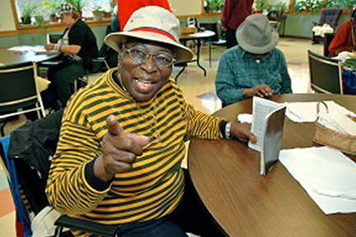
Conclusions
National organizations such as the Institute of Medicine, SAMHSA, NCOA, and the National Coalition on Mental Health and Aging have been calling attention to the need for training in the area of behavioral health and aging and for “critical strategies to address the current and future shortfall” (NCOA, 2022). Training staff at senior centers is one strategy to address this need.
Additional state and federal funding is needed to support workforce training in order to sustain these important training initiatives and improve the care of older adults.
Acknowledgement:
This project was funded by RRF Foundation for Aging

Slide 15
Volunteer Engagement in the Aging Network
Notes:
Now we will talk about the course. Clarify that this is a course for volunteer coordinators, not for volunteers

Slide 16
Importance of Volunteers
According to the Administration for Community Living, the economic value of Area Agencies on Aging unpaid volunteers in 2019 was approximately $1.7 billion.
Volunteers are a key human resource
They participate in programmatic, fundraising, and administrative services
They provide a connection to the greater community
They may also be future leaders in your organization
Sizeable overlap between people who volunteer and provide financial support to organizations (2022):
Fidelity Charitable found that 62% of charitable donors are recent volunteers
39% of volunteers support a nonprofit by volunteering before they make financial donations
Notes:
Many aging network agencies rely heavily on the work of volunteers to provide essential services including case assistance, meal delivery, home visits, and recreational activities. Volunteers also help connect organizations to the greater community.

Slide 17
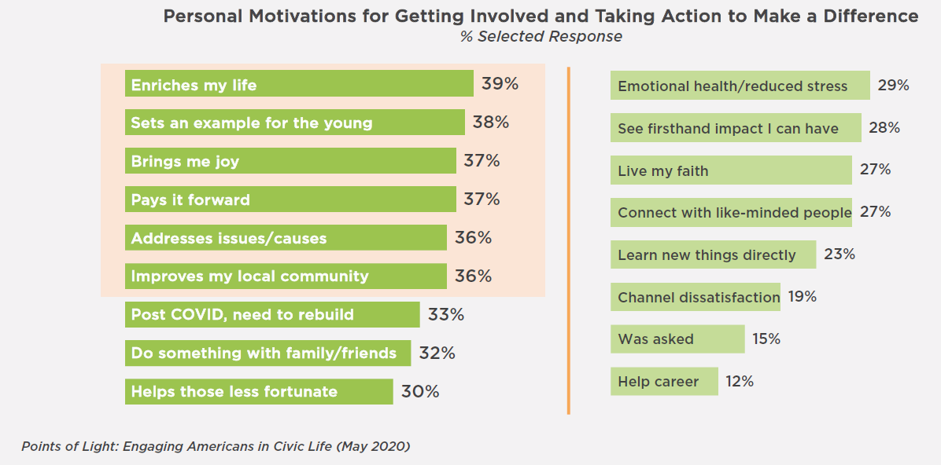
Why People Volunteer

Slide 18
Course Overview
Course Features: 2.5 hour online course
Goal: To provide an overview of the knowledge, skills, and values necessary for you to assess and strengthen your volunteer program. Sample forms and worksheets will be provided for each section making the course practical for COAs.
What you will learn:
Planning - Describe the components of your volunteer program
Develop a targeted volunteer recruitment campaign
Train and manage program for effective retention
Learn how to identify process and outcome measures to evaluate your volunteer program

Slide 19
Course Content Areas
Planning
Recruiting
Training
Managing
Evaluating
Define your mission
Assess your organization
Develop you volunteer program
Describe volunteer positions
Assess your image
Decide how to recruit
Develop your message
Find volunteers
Select volunteers
Screen volunteers
Develop your orientation program
Assign orientation leaders
Schedule orientation
Develop materials
Conduct the orientation
Train your volunteers
Assign a supervisor
Communicate with volunteers regularly
Evaluate your volunteers
Avoid volunteer burnout
Recognize your volunteers’ efforts
Describe your program
Design the evaluation
Collect data
Analyze the data
Report results

Slide 20
Course : Worksheets and examples
Job Description Worksheet
Scenario:
You are the volunteer coordinator at a COA. You need to hire 5 volunteer front desk receptionists.
The template can help to create a job description.

Slide 21
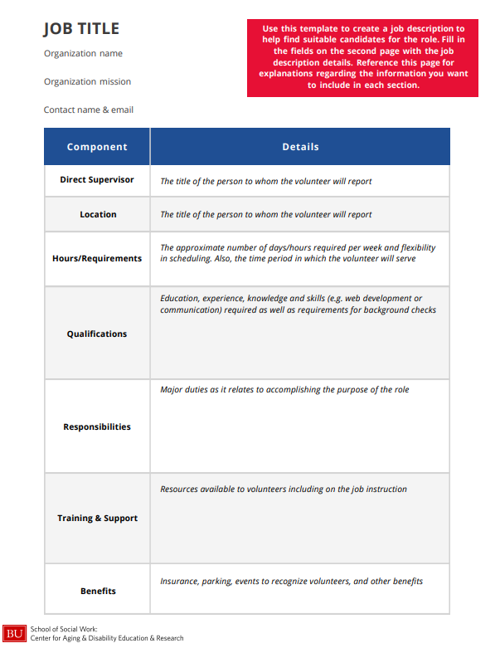

Slide 22
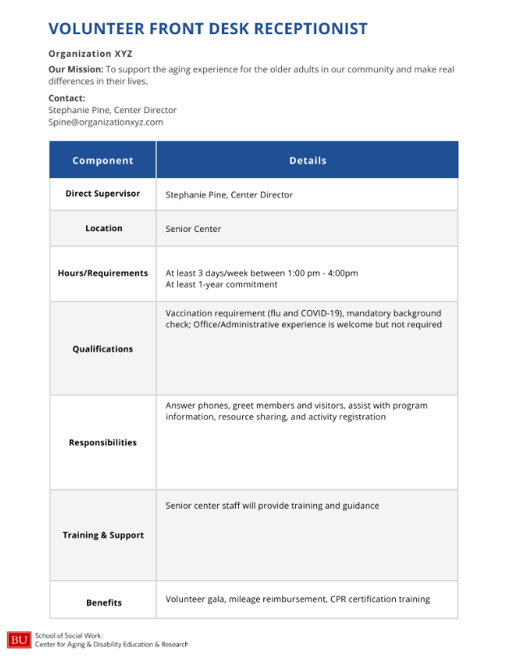

Slide 23
Sample Worksheet : Evaluate Your Volunteer Program
Sample evaluation questions:
Adequate Support
Were you satisfied with the supervisor support you received?
Very satisfied Satisfied Neither satisfied nor dissatisfied Dissatisfied Very dissatisfied
Meaningful Work
I feel that my volunteer work has an impact.
Almost Always Often Sometimes Seldom Never
Physical or mental well-being as a result of volunteering
I have experienced increased physical or mental well-being since becoming a volunteer.
Yes No Unsure

Slide 24
Volunteer Engagement in the Aging Network:
Course Evaluation Results

Slide 25
Results: Competencies
At the beginning and end of the course, learners were asked to rate their skill level in nine competencies using the scale: 0 - Not skilled at all; 1 - Beginning skill; 2 - Moderate skill; 3 - Advanced skill; 4 - Expert skill.
4 (Expert skill)
3 (Advanced skill)
2 (Moderate skill)
1 (Beginning skill)
0 (No experience)
Identify the basic components of strategic volunteer management. (88% increase)
Understand the role of the volunteer manager. (52% increase)
Understand trends and contextual factors for how volunteer programs are changing. (130% increase)
Identify characteristics of centralized, decentralized & hybrid volunteer management program structures. (136% increase)
Develop a volunteer job description. (63% increase)
Develop a targeted recruitment campaign for volunteers. (81% increase)
Prepare your organization to work with volunteers. (60% increase)
Build relationships and provide support to your volunteers for long-term retention. (52% increase)
Identify process and outcome measures to evaluate and monitor your volunteer program. (125% increase)
Notes:
All increases were statistically significant

Slide 26
Results: Course Objectives
At the end of the course, learners were asked whether they felt that the course met the learning objectives using the scale: 1- Strongly disagree; 2 - Disagree; 3 - Neutral; 4 - Agree; 5 - Strongly agree.
Learning Objective | Percent of Learners Who Agreed or Strongly Agreed
Describe and understand the components of volunteer management. | 96%
Understand different methods to develop or strengthen your volunteer program. | 98%
Identify ways to make your volunteer program more inclusive. | 95%
Engage your volunteers for effective retention. | 93%
Identify process and outcome measures to evaluate your volunteer program. | 95%

Slide 27
Results: Course Evaluation
At the end of the course, learners were asked how much they agreed or disagreed with a series of course evaluation statements using the scale: 1- Strongly disagree; 2 - Disagree; 3 - Neutral; 4 - Agree; 5 - Strongly agree; 6 - Non-applicable.
Evaluation Statement | Percent of Learners Who Agreed or Strongly Agreed
This training expanded my knowledge and understanding of the topic area. | 98%
The course materials were suitable and useful. | 96%
This training will help me apply practice skills in the topic area. | 94%
I would recommend this course to my colleagues. | 92%

Slide 28
Learner Feedback
What did you find most helpful about this course?
Sample documents | “The samples of forms and resources are always helpful with examples.” “Downloadable content to use and templates.” “The resource documents for future reference.” “The Resources and Examples because I’m a visual person.”
Concrete steps | “Step-by-step instructions on volunteer recognition, recruitment, and engagement.” “Helpful examples of documents and concrete steps to take in order to improve our volunteer program.” “Strategies for creating inclusive volunteer programs.”
Information on volunteer retention | “How to create a plan to retain volunteers.” “It had helpful ideas about volunteer retention and surveys that I hadn’t considered.”
Information on volunteer management and training | “The volunteer management checklist will be very helpful to me moving forward.” “Onboarding and Training.” “Management and training to volunteers.”

Slide 29
Learner Feedback
What changes do you anticipate making after taking this course?
Volunteer job descriptions | “Write specific job descriptions.” “More clearly defined job descriptions for volunteers.”
Volunteer management | “Creating a formalized volunteer management process.” “Implement a strategic plan.”
Volunteer recognition and support | “We will be adding more ways to recognize volunteers, getting volunteer feedback and adding more training.” “More check ins with volunteers to see how things are going, providing feedback, and thanking them.” “Ask current volunteers for feedback to give me insight as to how to make their experiences better. Increase diversity of volunteer pool. Increase recognition of volunteers.”
Evaluations | “I am going to create a survey for volunteers to provide feedback about what would make their jobs better/easier/more fulfulling.” “Incorporating surveys and evaluations.” “Better assessment of our volunteer management processes.”

Slide 30
Learner Feedback – General Comments
"Great course, so helpful suggestions that we will incorporate in our volunteer program."
"This was an extremely helpful course, especially in providing ways in how to examine certain processes currently in place."
"I would recommend this course to anybody managing volunteers."
"Thank you for opening this up to the public. Volunteers make a lot of necessary change that would otherwise be unattainable. It’s important to me as a Volunteer Coordinator that I am able to communicate the huge difference they make, and provide a solid, healthy volunteer experience for them too."
"I feel that this improved my knowledge on how to manage volunteers at my center."

Slide 31
Contact Us
Bronwyn Keefe, PhD, MSW, MPH
Director, CADER & Network for Professional Education
Assistant Dean of Workforce and Professional Development
Research Assistant Professor
bronwyn@bu.edu
Kathy Kuhn, MSW, LICSW
Special Projects
kkuhn@bu.edu
Annalee Wilson, MPH, CPH
Manager, Workforce and Curriculum Development
annaleew@bu.edu
Contact CADER:
https://thenetwork.bu.edu/cader/
cader@bu.edu

